Slide 1
Capstone Project 1
Hotel Booking Analysis Team : Impact players Rahul Kumar Aparna Khale Anwar Sujata Jadhav Mohammad Aasif Malik Submitted on 25th September 2022

Slide 2


Dataset input and problem Statement
The hotel industry is one of the most important components of the wider service industry, catering for customers who require overnight accommodation. It is also closely associated with the travel industry and the hospitality industry,
For this project we are analyzing hotel booking data of a city hotel and a resort
hotel of few years. The information includes the booking time, check in and
check out time, room and meal type, customers stay time, the visitors break up,
available parking spaces, visitors’ origin, cancellation cases.
The key objective of this project to analyze and explore the given data to conclude the meaningful important factors which can help the hotel management to improve both revenue and quality. Also mainly root cause analysis for the cancellation cases can be scrutinize to take necessary preventive actions.

Slide 3

Objective – key questions
Hotel type analysis
Find peak business season of hotel booking
Hotel revenue from ADR (Average daily rate)
Type of rooms
Meal Consumption Analysis
Waiting time Analysis
Customer wise analysis
Country origin customer analysis
Distributor Channel Analysis
Agent wise bookings Analysis
Company wise bookings Analysis
Market Segment -Booking Analysis
Hotel booking cancellation on basis of days_in_waiting_list and required_car_parking_spaces
Analysis of is_repeated_guest column
Number of weekdays booked by distribution channel
Number of weekend nights booked by distribution channel

Slide 4

Activity Work flow
Data Collection and understanding the problem.
We will be going through each variable and do a logical analysis about their meaning and importance for this problem.
Data cleaning and manipulation
We'll clean the dataset and handle the missing data, outliers and categorical variables.
Test assumptions. We'll check if our data meets the assumptions required by most multivariate techniques.
EDA ( Exploratory Data Analysis) and visualization
Univariate analysis
The data we are analyzing is only one variable
Bivariate analysis
We are comparing two variables to study their relationship
Multivariate analysis
Same as Bivariate analysis but only we are comparing more than two variables

Slide 5
Data Collection and understanding dataset input
Data Input | Description
hotel | City and Resort hotel
is_canceled | indicating booking cancelled (1) or not canelled (0)
lead_time | the time difference between booking date and actual check in
arrival_date_year | Year of arrival date
arrival_date_month | Month of arrival date
arrival_date_week_number | Week no of year for arrival date
arrival_date_day_of_month | day of arrival date
stays_in_weekend_nights | no of weekends night
stays_in_week_nights | no of week nights
adults | no of adults
children | no of children
babies | no of babies
meal | type of meal
country | customers country of origin
market_segment | Market segment type
distribution_channel | booking description channel
is_repeated_guest | if repeated guest (1) or no(0)

Slide 6
Data Collection and understanding dataset input
Data Input | Description
previous_cancellations | no of previous bookings those are cancelled by the customer before the current booking
previous_bookings_not_canceled | no of previous bookings not cancelled by the customer before the current booking
reserved_room_type | Type of reserved room
assigned_room_type | Type of assigned room
booking_changes | no of changes made in the booking from the moment the booking was entered till check in or cancellation
deposit_type | no deposit or refundable or non refundable
agent | ID of travel agent
company | ID of the company that made the booking
days_in_waiting_list | no of days the booking was in waiting list
customer_type | type of customer contract,group
adr | Average daily rate
required_car_parking_spaces | required car parking spaces
total_of_special_requests | no of special request
reservation_status | reservation last status
reservation_status_date | check out date

Slide 7
Dataset Input data summary
Hotel Booking Dataset
Numeric
lead_time, arrival_date_year, arrival_date_week_number, arrival_date_day_of_month, stays_in_weekend_nights, stays_in_week_nights, adults, children, babies, adr, required_car_parking_spaces, total_of_special_requests,
Binary
is_canceled, is_repeated_guest
Categorical
Hotel, arrival_date_month, meal, country, market_segment, distribution_channel, reserved_room_type, assigned_room_type, deposit_type

Slide 8

Data Collection and understanding dataset input
Prerequisites
Import Python libraries.
Mount google drive to google colab
Authorize notebook to access google drive files
Understanding dataset input
Find out the total columns and rows of dataset
Find the data type of each column.
Find the continuous and categorical data
Find individual distribution for some of the columns
Also check the correlation between dependent columns

Slide 9
Data cleaning and manipulation
Extract the unique values of each column content from the hotel booking dataset.
Dataset size : 119390 rows × 32 columns
Identify duplicated rows and remove the same.
Dataset size : 87396 rows × 32 columns
Calculate percentage values of null values of each column.
Combine the null_value and null_value_percentage series in the data frame using ‘concat’ method.
Replace NaN values with 0 for heading Agent & company
Replace NaN values with their mean values for heading children
Replace NaN values with 'others' for heading Country
Modify datatype from float to int64 for heading Agent, Company, Children

Slide 10
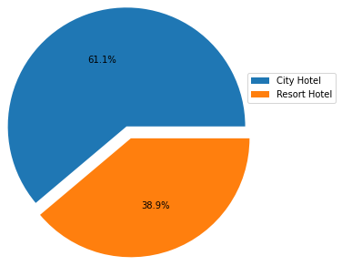
EDA ( Exploratory Data Analysis)
1.Hotel type analysis
Q1.Find type of hotel
Output : array(['Resort Hotel', 'City Hotel'], dtype=object)
Q2.Find count of booking as per type of hotel
Output:
Sr Hotel type Number of booking
0 City Hotel 53428
1 Resort Hotel 33968
Conclusion :
Booking of city hotel[61.1%] is more than compared to resort hotel[38.9%]

Slide 11
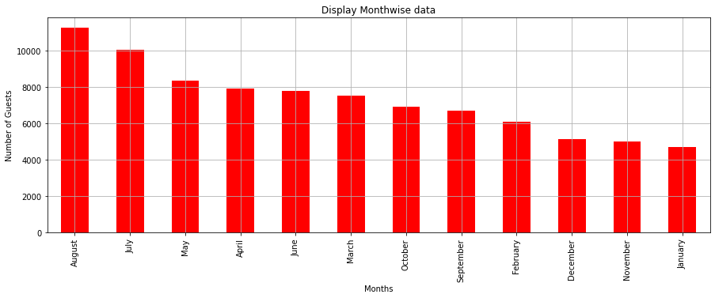
EDA ( Exploratory Data Analysis)
2. Find peak business season of hotel booking
Q1. Display the number of cumulative booking months wise
Conclusion:
As per bar plot shows, May: August month is a peak season for the hotel business whereas November and December is slack seasons.

Slide 12
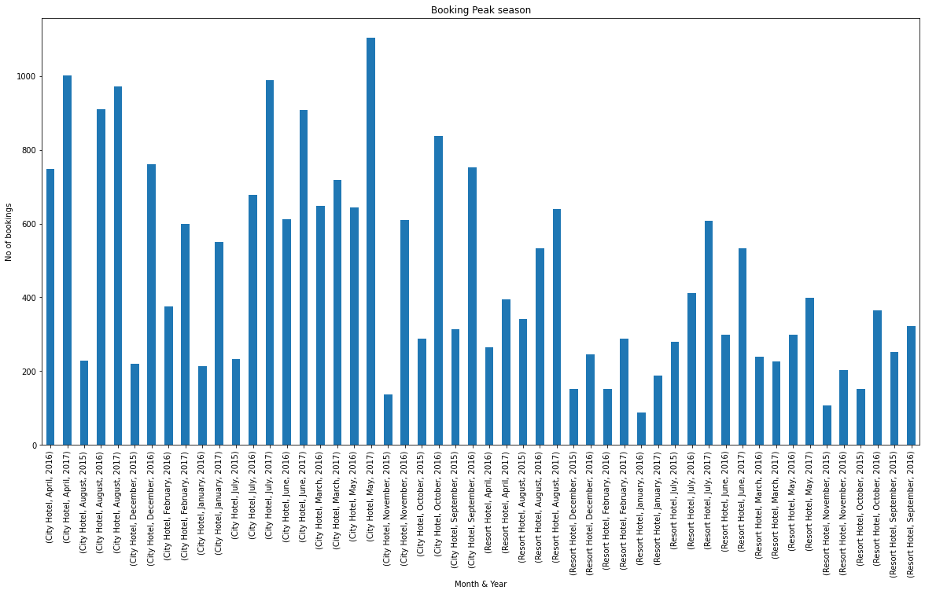
EDA ( Exploratory Data Analysis)
2. Find peak business season of hotel booking
Q2. Display no. of booking as per month and year.

Slide 13
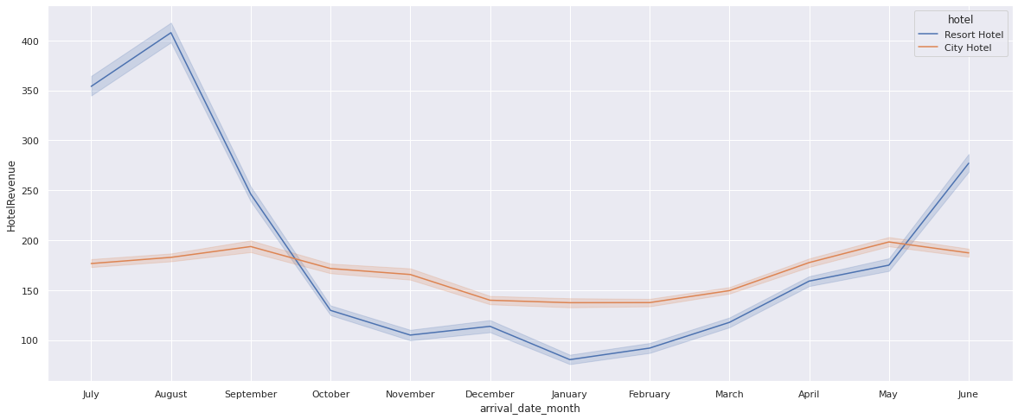
EDA ( Exploratory Data Analysis)
3. ADR (Average daily rate)
Q1. Find total no. of guests on basis of adults,children and babies.
Q2. Find ADR per person.
Q3. Find total no. of stay on basis of week nights and weekend nights.
Q4. Find hotel revenue=ADR per person * no. of days
Conclusion : Resort hotel is getting more revenue in the month of August.

Slide 14
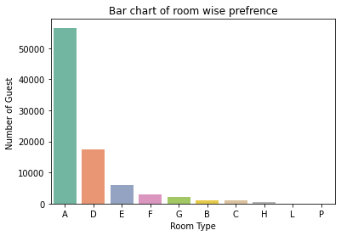
EDA ( Exploratory Data Analysis)
4. Type of rooms
Q1.How many types of rooms are provided through Hotels?
Output : array(['C', 'A', 'D', 'E', 'G', 'F', 'H', 'L', 'P', ‘B’]
Q2.Which is the most preferred room by the guest?
Conclusion :” A" type room is more preferred by the guests.

Slide 15
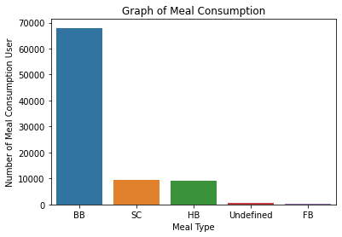
EDA ( Exploratory Data Analysis)
5. Meal Consumption Analysis
Q1. Which type of meal offer by hotel?
Output : array(['BB', 'FB', 'HB', 'SC', 'Undefined'], dtype=object)
Q2. Which is the most preferred meal consumption by guests?
Output :
Meal_type number_of_preference
0 BB 67978
1 SC 9481
2 HB 9085
3 Undefined 492
4 FB 360
Conclusion :"BB" meal type is mostly preferred by the guests.

Slide 16
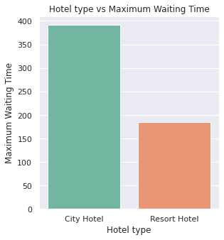
EDA ( Exploratory Data Analysis)
6. Waiting time Analysis
Q1. Analyze in which type of hotel there is more waiting time
Output:
Sr. Hotel Max_Waiting_Time
0 City Hotel 391
1 Resort Hotel 185
Conclusion :City Hotel having overall more waiting time which interprets that it is more crowded than Resort.

Slide 17
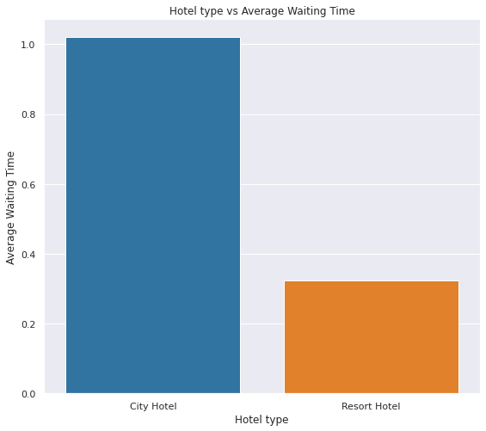
EDA ( Exploratory Data Analysis)
6. Waiting time Analysis
Q2. Analyze the average of type of hotel there is more waiting time
Output:
Sr Hotel Avg_Waiting_Time
0 City Hotel 1.020233
1 Resort Hotel 0.323834
Conclusion :As city hotels are preferred most by guests , it's having more waiting period.

Slide 18
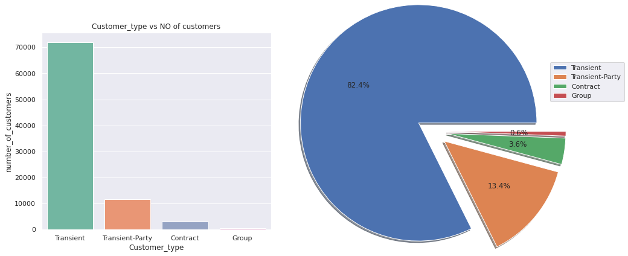
EDA ( Exploratory Data Analysis)
7. Customer wise analysis
Q1. Find out count of customers on basis of customer type.
Output:
Sr Customer type number_of_customers
0 Transient 71986
1 Transient-Party 11727
2 Contract 3139
3 Group 544
Conclusion :The maximum number of guest are from transient category which is near about 75.1%.

Slide 19
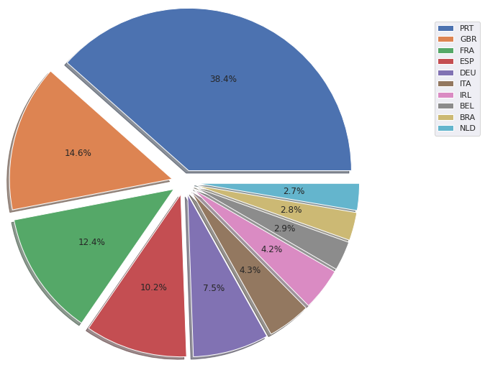
EDA ( Exploratory Data Analysis)
8. Country origin customer analysis
Q1. Analyze the data from which country guests are visiting most.
Output:
Sr country_name number_of_guests
0 PRT 27453
1 GBR 10433
2 FRA 8837
3 ESP 7252
4 DEU 5387
5 ITA 3066
6 IRL 3016
7 BEL 2081
8 BRA 1995
9 NLD 1911
Conclusion:
Below top 5 countries from which most guests are visiting
1.PORTUGAL(PRT)-->38.4%
2.GREAT BRITAIN(GBR)-->14.6%
3.FRANCE(FRA)---->12.4%
4.SPAIN (ESP)--->10.2%
5.GERMANY (DEU)---->7.5%

Slide 20
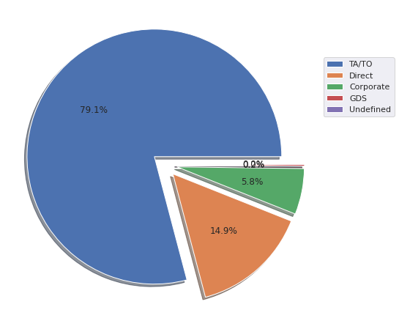
EDA ( Exploratory Data Analysis)
9. Distributor Channel Analysis
Q1. Find out which distribution channel is giving the most booking business.
Output:
Sr Distribution Type NumberofBookings
0 TA/TO 69141
1 Direct 12988
2 Corporate 5081
3 GDS 181
4 Undefined 5
Conclusion : Distributor Channel Analysis TA/TO is giving the most booking business

Slide 21
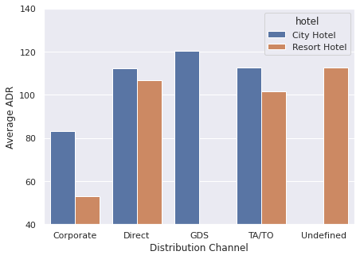
EDA ( Exploratory Data Analysis)
9. Distributor Channel Analysis
Q2.Which distribution channel is giving more business to respective hotels?
Output:
1.TA/TO -->69141 i.e. 79.1%
2.Direct -->12988 i.e. 14.9%
3.corporate -->5081 i.e. 5.8%
4.GDS -->181 i.e. 0.2%
5.undefined -->5 i.e. close to 0.001%
Conclusion : Distributor channel TA/TO is giving the most booking business

Slide 22
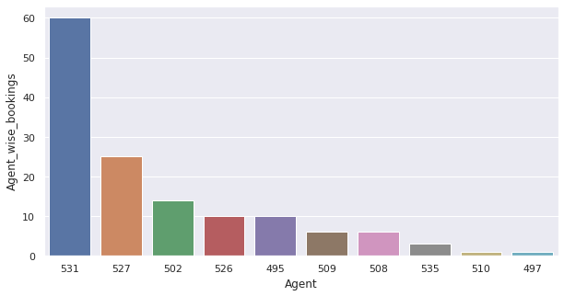
EDA ( Exploratory Data Analysis)
10. Agent wise bookings Analysis
Q1.Which agent giving more business to respective hotels?
Output:
Conclusion :Agent ID 531 is giving maximum hotel bookings so this data can be utilized to decide commission % for the agent

Slide 23
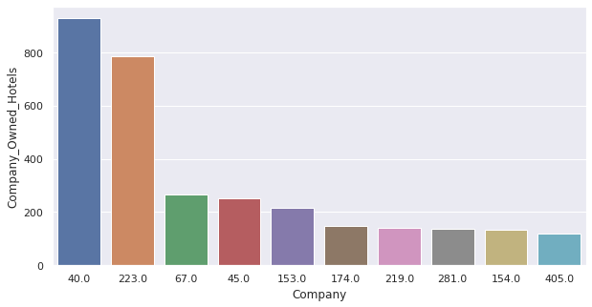
EDA ( Exploratory Data Analysis)
11. Company wise bookings Analysis
Q1.Which company owning how many hotels?
Output:
Sr Company Company_Owned_Hotels
0 40.0 927
1 223.0 784
2 67.0 267
3 45.0 250
4 153.0 215
5 174.0 149
6 219.0 141
7 281.0 138
8 154.0 133
9 405.0 119
Conclusion : Above graph shows company wise owning maximum no of hotels

Slide 24
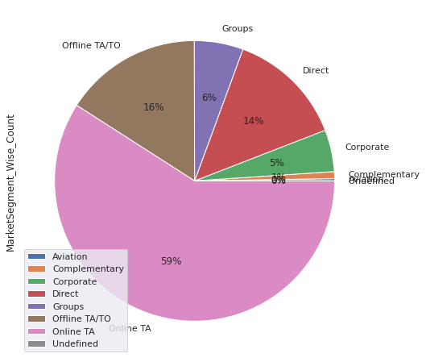
EDA ( Exploratory Data Analysis)
12. Market Segment -Booking Analysis
Q1.Which market segment is giving more business?
Output:
Sr MarketSegment MarketSegment_Wise_Count
0 Online TA 51618
1 Offline TA/TO 13889
2 Direct 11804
3 Groups 4942
4 Corporate 4212
5 Complementary 702
6 Aviation 227
7 Undefined 2
Conclusion : Online TA is most commonly used market segment for the booking purpose.

Slide 25
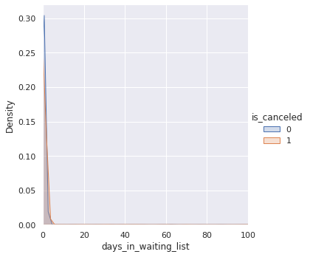
EDA ( Exploratory Data Analysis)
13. Hotel booking cancellation on basis of days_in_waiting_list and required_car_parking_spaces
Q1. Waiting List Vs Cancellations
Output:
Conclusion : There are high chances of cancellation when the waiting period is high.

Slide 26
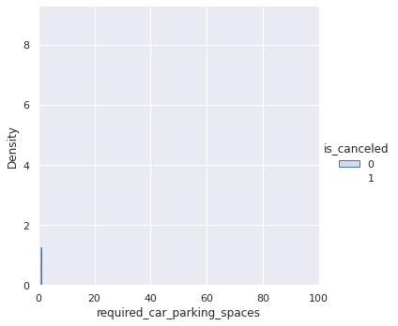
EDA ( Exploratory Data Analysis)
13. Hotel booking cancellation on basis of days_in_waiting_list and required_car_parking_spaces
Q2. Car Parking Vs Cancellation
Output:
Conclusion : There is no impact on cancellation due to car parking space

Slide 27
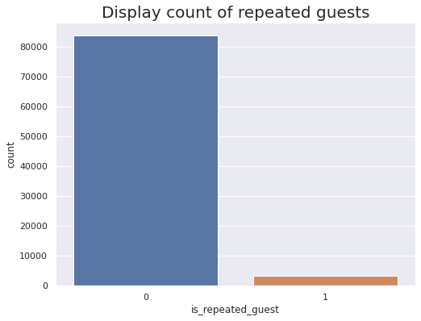
EDA ( Exploratory Data Analysis)
14. Analysis of is_repeated_guest column
Q1. Volume flow of repeated guest
Output:
Conclusion : Above data shows that most of the guests are visiting first time.

Slide 28
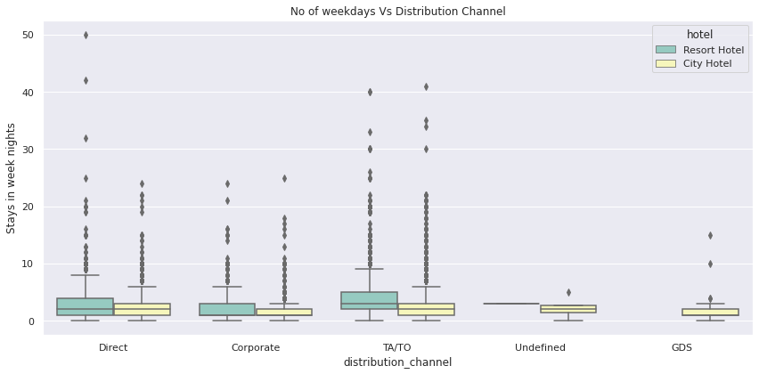
EDA ( Exploratory Data Analysis)
15. Number of weekdays booked by distribution channel
Conclusions :
1.Visitors from direct and corporate distribution channel are staying almost in same range numbers of week nights.
2.TA/TO distribution channel has some deviation over stays week-nights between Resort and City hotels.
3.Undefined and GDS distribution channel visitors had not shown interest in the Resort Hotel.

Slide 29
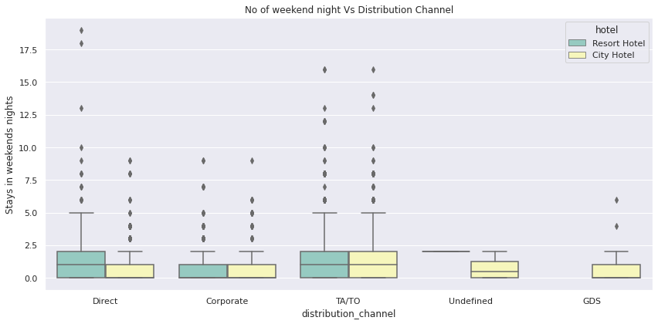
EDA ( Exploratory Data Analysis)
16. Number of weekend nights booked by distribution channel
Conclusion :
1.Direct distribution channel visitors prefer to stay more weekend nights in the Resort Hotel type.
2.Visitors through Corporate and TA/TO distribution channel are equally preferring between Resort and City hotels.

Slide 30
EDA ( Exploratory Data Analysis)
Mainly performed using Matplotlib and Seaborn library and the following graph and plots had been used:
Bar Plot
Pie Chart
Line Plot
Box Plot

Slide 31
Conclusions
1.City hotel[61.1%] having more booking as compared to resort hotel[38.9%]."
2.Overall from May: August month is a peak season for the hotel business whereas November and December is slack seasons.
3.Resort hotel is getting more revenue in the month of August."
4.City Hotel having overall more waiting time which interpret it is more crowded than Resort
5. Here we can see the maximum number of customers are from transient category which is near about 75.1%.
6.Distributor channel TA/TO is giving the most booking business
7.Agent ID 531 is giving maximum hotel bookings so this data can be utilized to decide commission % for agent
8.There are high chances of cancellation when waiting period is high.

Slide 32
Challenges
Dataset contains a lot of duplications.
Against few columns having a lot of Null values.
Few dataset columns with wrong datatype format.

Slide 33
Thank You

